Slide 1
PV Forecast model
Flow Chart
Made by gyeong gak, Kim

Slide 2
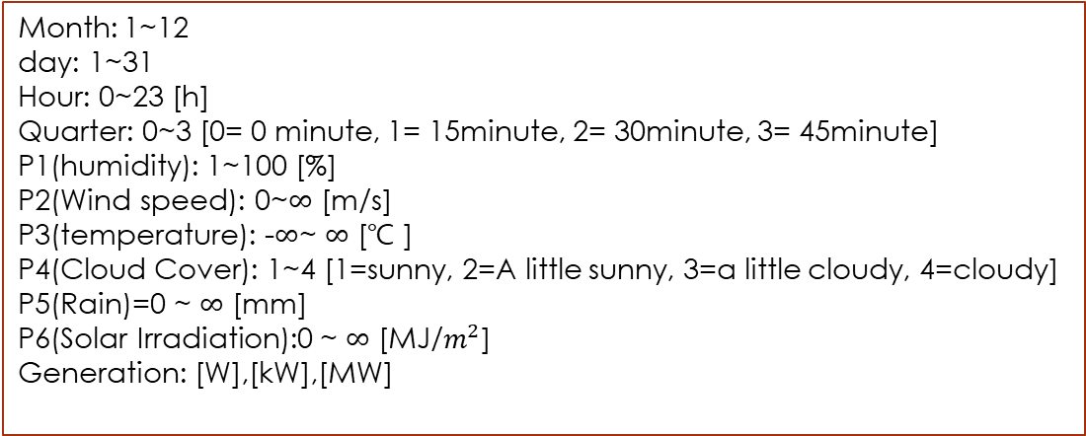
Data Foremat
Longterm data &
Shortterm data
Forecast data
Month: 1~12
day: 1~31
Hour: 0~23 [h]
Quarter: 0~3 [0= 0 minute, 1= 15minute, 2= 30minute, 3= 45minute]
P1(humidity): 1~100 [%]
P2(Wind speed): 0~$∞$ [m/s]
P3(temperature): -$∞$~ $∞$ [℃ ]
P4(Cloud Cover): 1~4 [1=sunny, 2=A little sunny, 3=a little cloudy, 4=cloudy]
P5(Rain)=0 ~ $∞$ [mm]
P6(Solar Irradiation):0 ~ $∞$ [MJ/$m^{2}$]
Generation: [W],[kW],[MW]

Slide 3
PVset_setPVModel
Longterm data
Get File path
Train data
Set valid day/data
Valid data
Train ANN
(PVset_ANN_Train)
1
Devide data
Vaild_predictors
Train Kmeans
(PVset_Kmeans_Train)
2
Train Forecast Model
Train LSTM
(PVset_LSTM_Train)
3
Validate model using valid data
Forecast using ANN
PVset_ANN_Forecast
4
Set coefficients each model using PSO
Forecast using K-means
PVset_Kmeans_Forecast
5
Intergrate individual model result
Forecast using LSTM
PVset_LSTM_Forecast
6
Calculate error
25x4
1x30
Build the error distribution
hour=1~25
Quarter=1~4
valid day=30
Save parameter
(.mat file)
PV_err_distribution.mat
PV_pso_coeff.mat

Slide 4
PVset_ANN_Train
Longterm data
1
Delete last 7days data
Set Past data
Delete row which has 0 generation
Between feature & gerneration
Calculate correlation
+time
Between feature & gerneration
Set feature column
Run 3 times
ANN model has big variance
Layer option: [20,20,20,15]
Experience best performance
Train function: Scaled conjugate gradient
It is faster because it uses GPU
Train Solar Forecast model (ANN)
Train Generation
Forecast model(ANN)
Save Forecast model
(.mat file)
PV_fitnet_ANN.mat
Notes:
시작

Slide 5
PVset_kmeans_Train
Longterm data
2
K-means use Euclidean distance so standardization is important
Data Standardization
Calculate correlation
Between feature & gerneration
+month
Data Format change
PVset_Format_Change
Between feature & gerneration
Train kmeans & baysian for solar (k=30)
1:Building index
2:Date / Month (12.15~3.15=1(winter), 5.15~8.15=3(summer), else= 2)
3:Humidity / max value
4:wind speed / mean value
5:Temparature / max value
6:Cloud / mean value
7:Rain / mean value
8:SolarIrradiance / mean value
9~104:Generation / 1~96 row → 9~104 column
days <=31
no
K=k_min : k_max
(5 : 30)
yes
Devide data
(70%/30%)
K=2
Train kmeans & baysian using 70%
Train kmeans & baysian
Forecast using vaild data(30%)
Calculate err & set k-value which has best performance
Train again using optimal k-value
Save Forecast model
(.mat file)
PV_Model.mat

Slide 6
PVset_LSTM_Train
Longterm data
3
Use Only 7 days data because of LSTM’s train speed
Set past data
Data Standardization
Between feature & gerneration
+time
Calculate correlation
Between feature & gerneration
Set feature & target
Set train option
LSTM Layer
sequenceInputLayer
lstmLayer(100)
lstmLayer(50)
fullyConnectedLayer
regressionLayer
Train LSTM for solar
Set feature & target
Train LSTM for generation
Save Forecast model
(.mat file)
PV_LSTM.mat

Slide 7

PVset_ANN_Forecast
Forecast data Shortterm data
Load .mat file
(PV_fitnet_ANN)
Error Correction 2
Delete row which has 0 generation
Load .mat file
Set data
Time= hour$+$0.25quarter
Forecast solar using ANN
Forecast Generation 3 times using shortterm
Forecast 3 time
Mean result of solar
Mean result
Error Correction 1
Forecast Generation using ANN
Find sunset,sunrise time
Delete the value except between the sunrise and sunset times.
Mean result of generation
Find sunset,sunrise
row in data
Calculate err rate & mean err rate
Error Correction
Delete the value except between the sunrise and sunset times.
Compensate the result by the mean error
Export results
result1
result2

Slide 8
PVset_kmeans_Forecast
Forecast data Shortterm data
1:Building index
2:Date / Month (12.15~3.15=1(winter), 5.15~8.15=3(summer), else= 2)
3:Humidity / max value
4:wind speed / mean value
5:Temparature / max value
6:Cloud / mean value
7:Rain / mean value
8:SolarIrradiance / mean value
9~104:Generation / 1~96 row → 9~104 column
Load .mat file
(PV_Model.mat)
Data standardization
Forecast solar using kmeans & baysian
Load .mat file
(PV_Model.mat)
patterning data
Forecast Generation using
Kmeans & baysian
3 times
Standardize shortterm data & Format change
Forecast Generation using
Kmeans & baysian
3 times
Mean result of generation
Return to the original data format
Error correction
Mean result of generation
Make 0 at night time & calculate mean error rate
Export result1
Export result2
Compensate the result by the mean error

Slide 9
PVset_LSTM_Forecast
Forecast data Shortterm data
Load .mat file
(PV_LSTM.mat)
Data standardization
Error Correction 2
Load .mat file
Forecast solar using LSTM
Forecast Generation 3 times using shortterm
Forecast Generation using LSTM
Mean result
Mean result of generation
Error Correction 1
Find sunset,sunrise time
Delete the value except between the sunrise and sunset times.
Return to the original data format
Find sunset,sunrise
row in data
Calculate err rate & mean err rate
Error Correction
Delete the value except between the sunrise and sunset times.
Compensate the result by the mean error
Export results
result1
result2

Slide 10

Pvget_getPVModel
Forecast data Shortterm data
Get File path &
Set parameter
.mat file check
Load .mat file
(PV_pso_coeff.mat
PV_err_distribution.mat)
Train ANN
(PVget_ANN_Train)
Forecast PV generation using each model
Train Kmeans
(PVget_Kmeans_Train)
Reflect coefficients in results
Train LSTM
(PVget_LSTM_Train)
Sort data(30,96)
Calculate time step
Select data with 95% size (upper)
Find last time’s row
Get deterministic result & Generate Result File
Select data with
5% size (lower)
Chang x-axis to 0~24
Reflect distribution at result
Make boundaries
Drawing graph of result
Make the confidence interval
PVget_getCI
Draw graph
PVget_Graph_desc
Calculate MAPE
abs(mean($\frac{predict−real}{real}))×100\%$

